Slide 1
March, 2018
ASP.NET
Ihnat Klimchuk

Slide 2
Hi there.
I’m Ihnat Klimchuk
Department: D3 G2
Technologies: .NET, JS, HTML, CSS, SQL, Memes
Software Engineer
Contact Information:
Phone: +375 29 148 43 71
Email: ihnat.klimchuk@itechart-group.com
Skype: ignatks47

Slide 3
Goals
Main:
Get familiar with ASP.NET web platform within next 6 meetings in order to accomplish test task till end of the lab.
Additional:
Fill knowledge gaps
Have fun during discussions

Slide 4
LECTURE CONVENTION
First of all

Slide 5
Plan
ASP.NET
History
Basics
ASP.NET CORE
Changes
ASP.NET CORE Common Tasks
Tasks and solutions in examples

Slide 6
LECTURE CONVENTION
Lectures will be split in logical parts
You can should ask question after each logical part during special slide
Questions should be somehow connected to ASP
We can afford breaks

Slide 7
Questions
Feel free to ask anything

Slide 8
ASP.NET
Deep Dive

Slide 9
History MILESTONES
1996 – ASP (Active Server Pages)
2002 – ASP.NET (ASP+)
2008 – ASP.NET MVC
2010 – ASP.NET Web Pages (Razor)
2012 – ASP.NET Web API, SignalR
2016 – ASP.NET CORE (ASP.NET 5, vNext)
2018 – You are here
Notes:
Things to say:
Long history
Step by step iterating over points listed here

Slide 10
Active Server Pages Facts
Released by Microsoft in 1996
ASP remains supported until 14 January 2020
ASP uses server-side scripting
ASP interpreter supports VBScript, PerlScript and JScript
JScript !== JavaScript
Notes:
ASP facts to say
Note that JScript is not JavaScript but implements ecmascript standards

Slide 11
Code sample
CODE SNIPPET
<%
Response.Write "Hello World!"
%>
<% @ Language = "JScript" %><%
Response.Write("Hello World!");
%>
Notes:
Sample to show
Note that it should be enough to know about ASP in 2018

Slide 12
ASP.NET Facts
Released in 2002
Compiled code
Based on .NET Framework
ASP.NET supports CLR languages (C#, VB.NET, F#, etc.)
Ability to use the code-behind development model
Extensions
Notes:
Say about new features in details and why it was important

Slide 13
ASP.NET Extensions
ASP.NET MVC
ASP.NET RAZOR (Web Pages)
ASP.NET Web API
ASP.NET SignalR
ASP.NET Web Forms
Others (ASP.NET Dynamic Data, ASP.NET AJAX, etc.)
Notes:
Say about extensions of ASP.NET and explain what they are responsible for

Slide 14
ASP.NET CORE Facts
Released in 2016
Light-weight and modular HTTP request pipeline
Cross-platform
Based on .NETSTANDARD (.NET Framework or Core)
Modular and distributed as Nuget packages
Open-source
Notes:
Say about ASP.NET CORE and explain why it was needed (legacy and modern web apps)

Slide 15
SHORT OVERVIEW
ASP
ASP.NET
ASP.NET CORE
1996
2002
2016

Slide 16
SHORT OVERVIEW
ASP.NET
ASP.NET MVC
ASP.NET Web API
ASP.NET SignalR
ASP.NET RAZOR
ASP.NET Web Forms
Others

Slide 17
Questions
Feel free to ask anything

Slide 18
WEBSITE TYPES in THEORY
Multi page website
Single page website
Server side rendering
Client side rendering
Web API
Notes:
Theory website development diagram
Explain it

Slide 19
WEBSITE TYPES in practice
Multi page website
Single page website
Server side rendering
Client side rendering
Web API

Slide 20
ASP.NET MVC
Deep Dive

Slide 21
HIGH LEVEL OVERVIEW
Browser
Internet
IIS
ASP.NET
Notes:
Explain ASP.NET high level model
Note IIS – is required and can’t be skipped

Slide 22
Mvc PATTERN
Controller
Model
View
Notes:
Note that everyone know MVC
Ask to draw lines

Slide 23
MVC in ASP.NET (NOT ORIGINAL)
Controller
Model
View
Notes:
Explain why it’s not original pattern
Explain why it’s required (splitting into parts)

Slide 24
Quote of the day
Talk is cheap. Show me the code.
Linus Torvalds

Slide 25
TOOLS
Visual Studio
.NET Framework
Brains

Slide 26
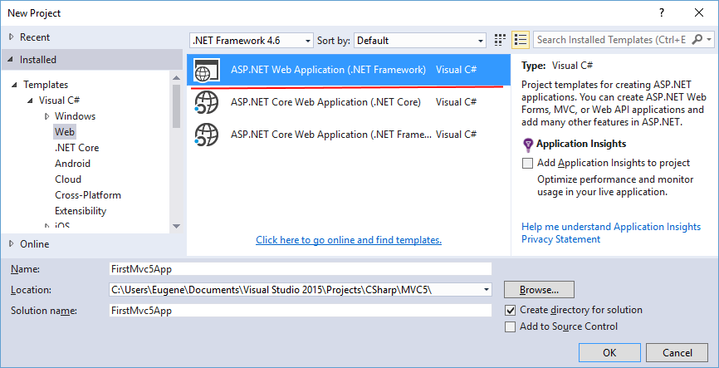
Create New Project

Slide 27
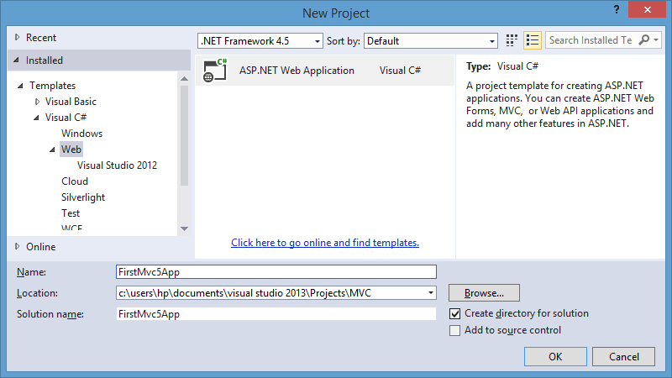
Create New Project

Slide 28
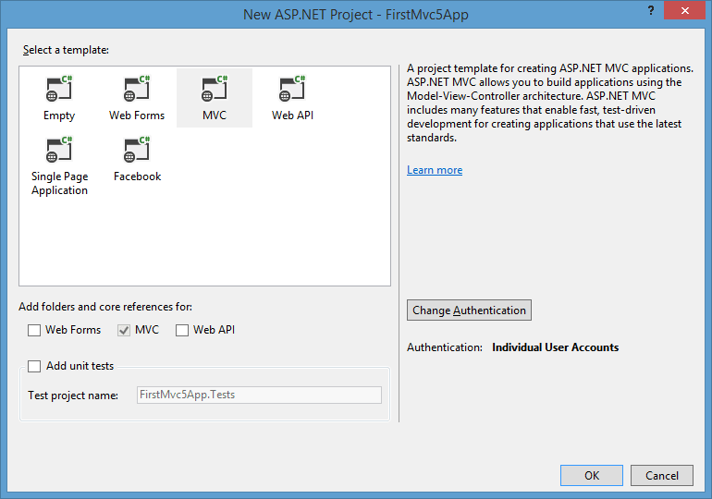
Create New Project

Slide 29
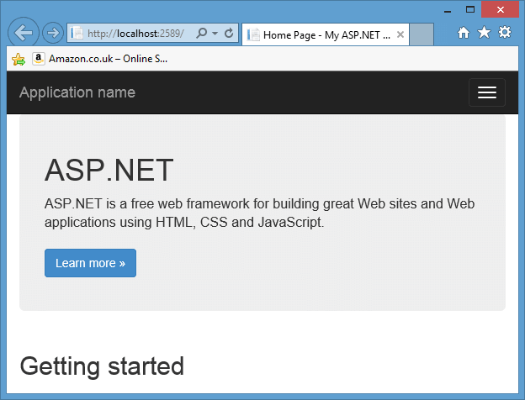
Create New Project

Slide 30
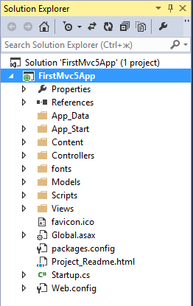
Create New Project
Notes:
Discuss project structure
Explain if somebody do not know what is VS

Slide 31
TASK 1: Static page WEBSITE
Create one page website
Should contain only one static page
Default page should display simple text
Default page should not contain any other resources
Notes:
Here we start with “Customer tasks” as step by step reasons of learning
Example:
“Customer” wants a landing page site with certain requirements…
Needed for further explanations

Slide 32
Router
CODE SNIPPET
public class RouteConfig
{
public static void RegisterRoutes(RouteCollection routes)
{
routes.IgnoreRoute("{resource}.axd/{*pathInfo}");
routes.MapRoute(
name: "Default",
url: "{controller}/{action}/{id}",
defaults: new { controller = "Home",
action = "Index",
id = UrlParameter.Optional }
);
}
}

Slide 33
HOME Controller
CODE SNIPPET
public class HomeController : Controller
{
public ActionResult Index()
{
return View();
}
}

Slide 34
HOME VIEW
CODE SNIPPET
<!DOCTYPE html>
<html>
<head>
<title>Home</title>
</head>
<body>
<div>Hello, this is home page.</div>
</body>
</html>

Slide 35
Congratulations! You know ASP.NET!
Not really…
Notes:
Some jokes required

Slide 36
Questions
Feel free to ask anything

Slide 37
TASK 2: Static 2 page WEBSITE
Create website second page
Should be static page
Second page should display current date
Second page date should be updated after refresh
Notes:
Here we start with “Customer tasks” as step by step reasons of learning
New task from “customer”

Slide 38
Router – NO CHANGES
CODE SNIPPET
public class RouteConfig
{
public static void RegisterRoutes(RouteCollection routes)
{
routes.IgnoreRoute("{resource}.axd/{*pathInfo}");
routes.MapRoute(
name: "Default",
url: "{controller}/{action}/{id}",
defaults: new { controller = "Home",
action = "Index",
id = UrlParameter.Optional }
);
}
}

Slide 39
HOME Controller
CODE SNIPPET
public class HomeController : Controller
{
public ActionResult Index()
{
return View();
}
public ActionResult About()
{
return View();
}
}

Slide 40
ABOUT VIEW
CODE SNIPPET
<!DOCTYPE html>
<html>
<head>
<title>About</title>
</head>
<body>
<div>Hello, today is ???</div>
</body>
</html>
Notes:
How to add date?

Slide 41

Let’s READ THE DOCS
Notes:
Splitter slide

Slide 42
View Engine
View Engine is responsible for the transformation of views into HTML, XML, or some other type of content.
View
View Engine
Content
Notes:
Explain what is Razor and how it works

Slide 43
Razor View Engine
Compact, Expressive, and Fluid
Easy to Learn
Is not a new language
Works with any Text Editor
Has great Intellisense
Unit Testable
Notes:
Blah blah blah Note that it was said some time ago by and maybe by marketers

Slide 44
RAZOR Example
CODE SNIPPET
<!-- Single statement block -->
@{ var myMessage = "Hello World"; }
CODE SNIPPET
<!-- Inline expression or variable -->
<p>The value of myMessage is: @myMessage</p>
CODE SNIPPET
<!-- Multi-statement block -->
@{
var greeting = "Welcome to our site!";
var weekDay = DateTime.Now.DayOfWeek;
var greetingMessage = greeting + " Here in Huston it is: " + weekDay;
}
<p>The greeting is: @greetingMessage</p>

Slide 45
RAZOR Example
CODE SNIPPET
@if (DateTime.Now.Year != 2007)
{
<p>Today is @DateTime.Now</p>
}
else
{
<p>O-la-la!</p>
}
CODE SNIPPET
@{
foreach (int item in array)
{
@(string.Format("Item is {0}", item))<br/>
}
}

Slide 46
RAZOR Example
CODE SNIPPET
@*
Comment
Comment
Comment
*@
@{
//Comment
}

Slide 47
LAYOUT
Layout eliminates constant repetition of the same structures and unnecessary copying.
_Layout.cshtml
Page1.cshtml
Page2.cshtml
Notes:
Explain the requirement of this feature

Slide 48
Layout
CODE SNIPPET
@*~/Views/Shared/_Layout.cshtml*@
<!DOCTYPE html>
<html>
<head>
<title>Layout</title>
</head>
<body>
@RenderBody()
</body>
</html>
CODE SNIPPET
@*Page.cshtml*@
@{
Layout = " ~/Views/Shared/_Layout.cshtm";
}
<p>This is Partial View</p>

Slide 49
Section
CODE SNIPPET
@*~/Views/Shared/_Layout.cshtml*@
…
@RenderBody()
<footer>@RenderSection("Footer")</footer>
…
CODE SNIPPET
@*Page.cshtml*@
@{
Layout = "../Shared/_Layout.cshtml";
}
@section Footer
{
<p>This is footer</p>
}
<p>This is Partial View</p>

Slide 50
Section
CODE SNIPPET
@*~/Views/Shared/_Layout.cshtml*@
…
@RenderBody()
<footer>@RenderSection("Footer")</footer>
<footer>
@if (IsSectionDefined("Footer")) {
@RenderSection("Footer")
}
else
{
<span>Default footer</span>
}
</footer>
…

Slide 51
Other Stuff To see
PartialView functionality
RenderPage functionality
Component functionality
Other
Notes:
Mentions that’s not all

Slide 52
FROM CONTROLLER TO VIEW
ViewData
ViewBag
Session
Model
Notes:
Explain the requirement of dataflow from controller to view

Slide 53
ViewData
CODE SNIPPET
public ActionResult TestViewData()
{
ViewData["TestData"] = "This is ViewData";
return View();
}
CODE SNIPPET
<html>
<head>…</head>
<body>@ViewData["TestData"]</body>
</html>

Slide 54
ViewBag
CODE SNIPPET
public ActionResult TestViewBag()
{
ViewBag.TestData = "This is ViewBag";
return View();
}
CODE SNIPPET
<html>
<head>…</head>
<body>@ViewBag.TestData</body>
</html>

Slide 55
MODEL
CODE SNIPPET
public class HomeModel
{...}
CODE SNIPPET
public ActionResult StrongTypeView ()
{
HomeModel model = new HomeModel();
return View(model);
}
CODE SNIPPET
@model HomeModel
<html>
<head>
<title>Strong Type</title>
</head>
<body>@Model.Field1</body>
</html>
PRESENTATION NAME

Slide 56
Model
CODE SNIPPET
public ActionResult StrongTypeView ()
{
var model = new { test = "Test" };
return View(model);
}
CODE SNIPPET
@model dynamic
<html>
<head>
<title>Dynamic</title>
</head>
<body>@Model.test</body>
</html>
PRESENTATION NAME

Slide 57
HTML Helper
CODE SNIPPET
@helper ListArrayItems(string[] array)
{
foreach (string item in Model.Values)
{
<text>@item</text>
}
}
<html>
<head>
<title> Inline HTML Helpers</title>
</head>
<body>
@ListArrayItems(Model.Values)
</body>
</html>
Notes:
Explain what is HTML Helpers

Slide 58
HTML Helper
CODE SNIPPET
public static class CustomHelpers
{
public static MvcHtmlString ListArrayitems(this HtmlHelper html,
string[] list)
{
TagBuilder tag = new TagBuilder("ul");
foreach (string str in list)
{
TagBuilder itemTag = new TagBuilder("li");
itemTag.SetInnerText(str);
tag.InnerHtml += itemTag.ToString();
}
return new MvcHtmlString(tag.ToString());
}
}

Slide 59
HTML Helper
CODE SNIPPET
@using WorkWithHtmlHelpers.Helpers.HtmlHelpers
...
<div>
@Html.ListArrayitems(Model.Values)
</div>
...

Slide 60
HTML Helper
CODE SNIPPET
@using (Html.BeginForm("CreateForm", "StandartHtmlHelpers", FormMethod.Post, new {@class = "text-form"}))
{
...
}

Slide 61
HTML Helper
CODE SNIPPET
@Html.CheckBox("myCheckbox", false)
@Html.Hidden("myHidden", "val")
@Html.RadioButton("myRadiobutton", "val", true)
@Html.Password("myPassword", "val")
@Html.TextArea("myTextarea", "val", 5, 20, null)
@Html.TextBox("myTextbox", "val")
@Html.DropDownList("myList", new SelectList(new [] {"A", "B"}), "Choose")
@Html.ListBox("myList", new MultiSelectList(new [] {"A", "B"}))

Slide 62
HTML Helper
CODE SNIPPET
@Html.CheckBoxFor(x => x.IsApproved)
@Html.HiddenFor(x => x.SomeProperty)
@Html.RadioButtonFor(x => x.RadioVal, "val")
@Html.PasswordFor(x => x.Password)
@Html.TextAreaFor(x => x.Bio, 5, 20, new{})
@Html.TextBoxFor(x => x.Name)
@Html.DropDownListFor(x => x.Gender, new SelectList(new [] {"M", "F"}))
@Html.ListBoxFor(x => x.Vals, new MultiSelectList(new [] {"A", "B"}))

Slide 63
HTML Helper
CODE SNIPPET
@Url.Content("~/Content/image.jpg")
@Html.ActionLink("Hi", "Index", "Link")
@Html.ActionLink("Hi", "Index", "Link", "https", "www.test.com", "anchor", new{}, null)
@Url.Action("Index", "Link")
@Url.RouteUrl(new { controller = "Link", action = "Index" })
@Html.RouteLink("Hi", new { controller = "Link", action = "Index" }, null)
@Html.RouteLink("Hi", "myNamedRoute", new {})

Slide 64
HTML Helper
CODE SNIPPET
@Html.TextBoxFor(x => x.Name, new {@class = "my-css-class", customAttribute = "custom"})

Slide 65
ABOUT VIEW
CODE SNIPPET
@*~/Views/Shared/_Layout.cshtml*@
<!DOCTYPE html>
<html>
<head>
<title>@ViewBag.Title</title>
</head>
<body>
@RenderBody()
</body>
</html>
CODE SNIPPET
@*About.cshtml*@
@{
Layout = " ~/Views/Shared/_Layout.cshtm";
}
<p>Hello, today is @DateTime.Now</p>

Slide 66
Questions
Feel free to ask anything

Slide 67
TASK 3: FORMS AND VALIDATION
Add new page
New page should contain feedback form
Text field should not be longer than 200 characters
Show error page if feedback is not valid
Notes:
Here we start with “Customer tasks” as step by step reasons of learning
New task from “customer”

Slide 68
Let’s READ THE DOCS
Notes:
Splitter slide

Slide 69
Validation Attributes
[Required]
[EmailAddress]
[Range(1, 5)]
[Phone]
[FileExtensions]
[RegularExpression(@"\d+")]
[StringLength(5, MinimumLength = 3)]

Slide 70
Model Validation
CODE SNIPPET
public class UserViewModel
{
[Required]
[MinLength(3)]
public string FirstName { get; set; }
[Required]
public string LastName { get; set; }
[Required]
public string Email { get; set; }
[Required]
[MinLength(3)]
public string Password { get; set; }
}

Slide 71
Validation in Controller
CODE SNIPPET
[HttpPost]
public ActionResult SaveUser(UserViewModel user)
{
if (ModelState.IsValid)
{
return View(“Success");
}
return View(“Error");
}

Slide 72
Common Action Results
ViewResult
RedirectResult
JsonResult
HttpNotFoundResult
ContentResult
FileContentResult
Notes:
List of ActionResults to use, mention that it’s not full list

Slide 73
Questions
Feel free to ask anything

Slide 74
TASK 4: CLIENT VALIDATION
Update feedback page
Feedback form should be validated on client side
Text field should not be longer than 200 characters
Show validation message if feedback is not valid
Notes:
Here we start with “Customer tasks” as step by step reasons of learning
New task from “customer”

Slide 75
Let’s READ THE DOCS
Notes:
Splitter slide

Slide 76
Client Validation
CODE SNIPPET
<configuration>
<appSettings>
<add key="ClientValidationEnabled" value="true" />
<add key="UnobtrusiveJavaScriptEnabled" value="true" />
</appSettings>
</configuration>
CODE SNIPPET
<script src="@Url.Content("~/Scripts/jquery.js")"></script>
<script src="@Url.Content("~/Scripts/jquery.validate.js")"></script>
<script src="@Url.Content("~/Scripts/jquery.validate.unobtrusive.js")"></script>
PRESENTATION NAME

Slide 77
Bundles
Bundles are added to page using special HTML helpers:
Styles.Render
Scripts.Render
CODE SNIPPET
<head>
<meta charset="utf-8" />
<meta name="viewport" content="width=device-width, initial-scale=1.0">
<title>@ViewBag.Title - My ASP.NET Application</title>
@Styles.Render("~/Content/css")
@Scripts.Render("~/bundles/modernizr")
</head>

Slide 78
Client Validation
CODE SNIPPET
<div>
<div class="editor-label">
First Name:
</div>
<div class="editor-field">
@Html.TextBoxFor(item => item.FirstName)
@Html.ValidationMessageFor(item => item.FirstName)
</div>
</div>

Slide 79
Localization of Validation Messages
Localization based on attributes' properties
CODE SNIPPET
[Required(ErrorMessage = @"This is required field.")]
[StringLength(20, MinimumLength = 3,
ErrorMessageResourceType = typeof(ValidationLocalizations),
ErrorMessageResourceName = "StringLengthError")]

Slide 80
Questions
Feel free to ask anything

Slide 81
TASK 5: auth
Add new feedback review page
Page should display list of feedbacks
Page should be available only for admin
Redirect unauthenticated users to error page
Notes:
Here we start with “Customer tasks” as step by step reasons of learning
New task from “customer”

Slide 82
Let’s READ THE DOCS
Notes:
Splitter slide

Slide 83
AUTH PROBLEM
Using IIS Authentication
Using code Authentication
Problem:
Close integration with IIS
Notes:
Explain problems of close integration with IIS
ASP legacy (There are several libraries that are used from ASP itself and haven’t been changed for years)
Requirements of web application changes in time, and classic ASP.NET wasn’t developed for modern web apps

Slide 84
OWIN
OWIN - Open Web Interface for .NET
OWIN is not a framework.
OWIN is a specification.
OWIN defines a standard interface between .NET web servers and web applications.
The goal of the OWIN interface is to decouple server and application
Katana - OWIN implementations for Microsoft servers and frameworks.
Notes:
Lets talk about OWIN

Slide 85
OWIN
ASP.NET
Middleware
Server
Host (IIS)
Notes:
How OWIN works (actually it’s middleware)

Slide 86
auth
CODE SNIPPET
public partial class Startup
{
public void Configuration(IAppBuilder app)
{
app.UseCookieAuthentication(new CookieAuthenticationOptions
{
AuthenticationType =
DefaultAuthenticationTypes.ApplicationCookie,
LoginPath = new PathString("/Account/Login")
});
}
}

Slide 87
auth
CODE SNIPPET
[Authorize]
public class FirstController : Controller
{
[HttpGet]
public ActionResult UsefulAction(string param)
{
//TODO: implement this action
}
[HttpPost]
[AllowAnonymous]
public ActionResult AnotherUsefulAction(string param)
{
//TODO: implement this action
}
}
Notes:
What is filters attributes?

Slide 88
Filter Types
Authorization (IAuthorizationFilter)
Authentication (IAuthenticationFilter)
Action (IActionFilter)
Result (IResultFilter)
Exception (IExceptionFilter)

Slide 89
Filters
Client
Server
http://website.com/Person/Edit
IIS
Routing
Filters
Action
Response

Slide 90
Action Filter
CODE SNIPPET
public class CustomActionFilterAttribute : FilterAttribute, IActionFilter
{
private Stopwatch _timer;
public void OnActionExecuting(ActionExecutingContext filterContext)
{
_timer = Stopwatch.StartNew();
}
public void OnActionExecuted(ActionExecutedContext filterContext)
{
_timer.Stop();
Logger.Info(string.Format("Action Executed for {0} milliseconds", _timer.ElapsedMilliseconds));
}
}

Slide 91
Questions
Feel free to ask anything

Slide 92
ASP.NET WEB API
Not So Deep Dive
Notes:
Not so deep jokes required

Slide 93
web api
Allows to build RESTful API
Separate configuration
Separate routes
Naming is important

Slide 94
web api Configuration
CODE SNIPPET
public class WebAPIApplication : HttpApplication
{
protected void Application_Start()
{
GlobalConfiguration.Configure(WebApiConfig.Register);
//other configuration
}
}

Slide 95
web api in nutshell
CODE SNIPPET
public class ValuesController : ApiController
{
// GET api/values
public IEnumerable<string> GetAll() {…}
// GET api/values/5
public string GetById(int id) {…}
// POST api/values
public void Post(string value) {…}
// PUT api/values/5
public void Put(int id, string value) {…}
// DELETE api/values/5
public void Delete(int id) {…}
}
Notes:
Almost the same thing

Slide 96
web api in nutshell
Web API | MVC
System.Web.Http.Controllers.IHttpController | System.Web.Mvc.IController
System.Web.Http.ApiController | System.Web.Mvc.Controller
System.Web.Http.Controllers.HttpRequestContext | System.Web.HttpContext
System.Net.Http.HttpRequestMessage | System.Web.HttpRequest
System.Net.Http.HttpResponseMessage | System.Web.HttpResponse
Notes:
Explain what is the problem of Web API and MVC
Support
Duplication
Naming issues
others

